Slide 1

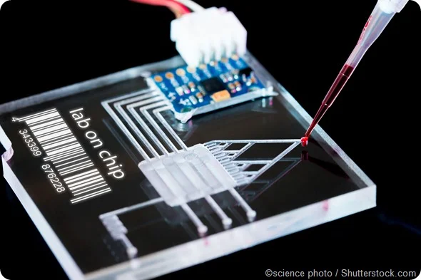

Final Demo
Interdigitated Electrodes in Microfluidics
Erin Ingram & Omar Mahmood
Faculty: Dr. Arum Han, Dr. Han Zhang
NanoBio Systems Lab
Notes:
Erin

Slide 2
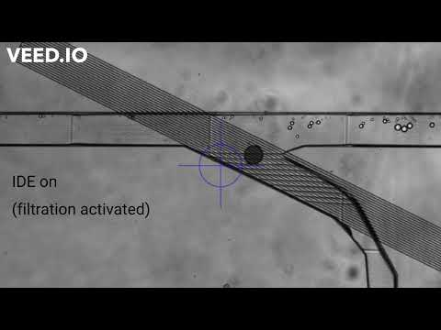
High-pass Filter Validation
Sorting out Large droplets
(>100 microns)
96%
efficiency

Slide 3
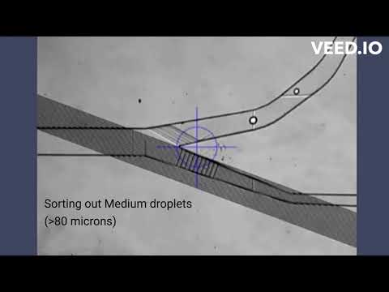
Band-pass Filter Validation
1st stage:
93%
efficiency
2nd stage:
92%
efficiency

Slide 4
Why did we use the IDEs that we did?
High-pass filter tested using 10 micron IDE
Band-pass filter tested using 5 micron IDE
Chose best quality IDEs
Some IDEs were completely dissolved away after wet etching
Chose devices with best bonding between IDE slide and channel chip to experiment with
Prevents leakage
We will investigate different IDE designs more in 404

Slide 5
Thanks! Questions?

